Slide 1
SLA improvements
By Beng Ren Siew

Slide 2
Overview
The dataset is a collection of helpdesk tickets that displays problems/incidents and request for software and IT. The primary goal is to provide timely solutions to the problem for each ticket.
The Service Level Agreement (SLA) is defined as the specific deadlines and expectations for handling customer issues and support request. Generally, refers to the response and resolution time.
The presentation is about possible recommendations and improvement on support to fulfil the SLA.

Slide 3
Improvements
1. Efficiency and Personnel
There are currently a total of 6 people across 7 teams that manage the different incident/ problems and requests. Each person is a part of multiple teams.
2. Educate and implement SLA into workflow
SLA standard is currently not implemented into workflow and therefore personnel follow due dates provided on the ticket.

Slide 4
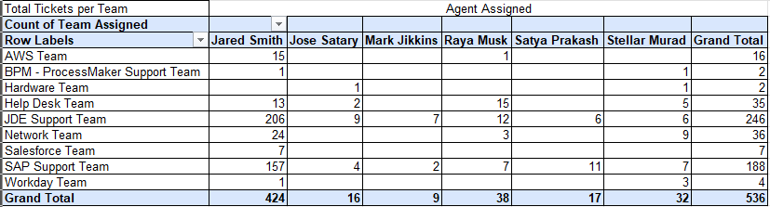
Personnel
This table shows all the teams and personnel that work to close the helpdesk tickets and how many ticket each person takes on in each team

Slide 5
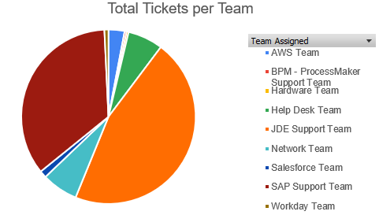
Efficiency
Shown in the Pie chart :
JDE Support team handles 45.90% of tickets
SAP Support team handles 35.07%

Slide 6
Efficiency
Amount of tickets Jared Smith deals with in total in each team compared to the overall tickets in each team.
Based on the overall tickets 536 and Jared Smith’s total tickets 424, he takes on 79.10% of all tickets in the dataset.

Slide 7
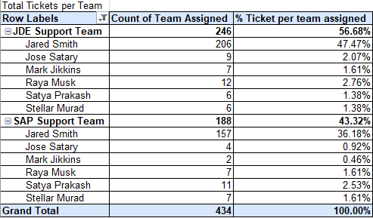
Efficiency
Of the two teams, Jared Smith is taking on the majority of the ticket: 47.47% of JDE and 36.18% of SAP
Table showing all tickets assigned to JDE and SAP support teams only

Slide 8
Efficiency
Suggestions and improvements:
Spread the distribution of tickets among the other team members to handle
If lacking in experience:
> Provide adequate knowledge transfer / training for ticket scenarios
> Senior should provide a well documented and clear SOP for less experience personnel
If current workforce is insufficient, it is recommended to potentially hire more personnel to handle the helpdesk tickets

Slide 9
Educate and Implement SLA into Workflow
To implement SLA, we have to educate all current personnel that handles helpdesk tickets on the SLA standards
Currently all personnel follow the due date provided for the tickets which does not strictly follow SLA standard which is based off the priority of the ticket

Slide 10
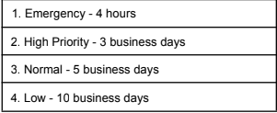
Educate and Implement SLA into Workflow
SLA Standard:
These are the SLA standard that has been set.
It is how long a ticket should take to be closed based on priority as soon as the ticket is created.

Slide 11
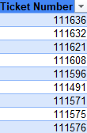
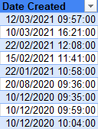
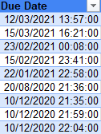
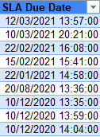
Educate and Implement SLA into Workflow
This table displays the first 10 tickets shown in the dataset containing when the ticket was first created and the Due Date created along with the SLA Due Date.
They are all ‘Emergency’ priority.
This dataset shows that the initial Due Date create has no set standard and the Due Date is likely to be different in duration than the 4 hr SLA standard for ‘Emergency’ priority. Similarly, the case will likely be the same for the other priorities as well.

Slide 12
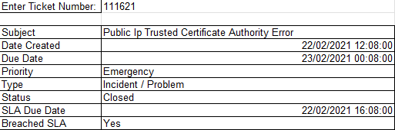
Educate and Implement SLA into Workflow
Example:
The date the ticket is created is 22/02/2021 12:08:00
SLA Due Date: 22/02/2021 16:08:00 – 4hrs after ticket is created
Breached SLA: Yes
Due Date: 23/02/2021 00:08:00 – Due date set by ticket (Not SLA standard)
Breach is likely due to following Ticket Due Date

